Slide 1
IPL ASSIGNMENT
SUBMITTED BY –
PARAG RANJAN BEHERA

Slide 2
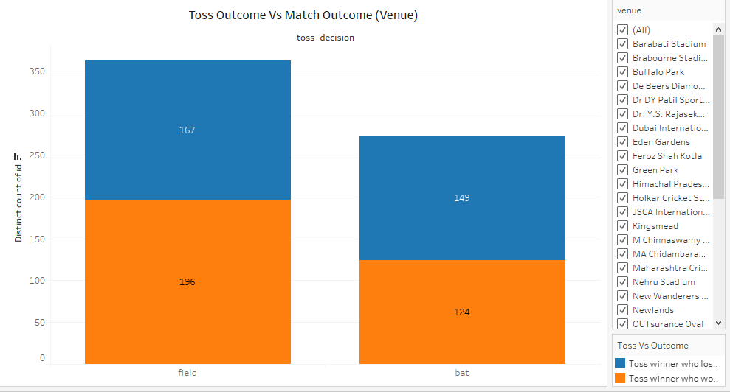
The Toss winner who opted for fielding first have won more matches.
The Toss winner who opted for batting first have lost more matches.

Slide 3
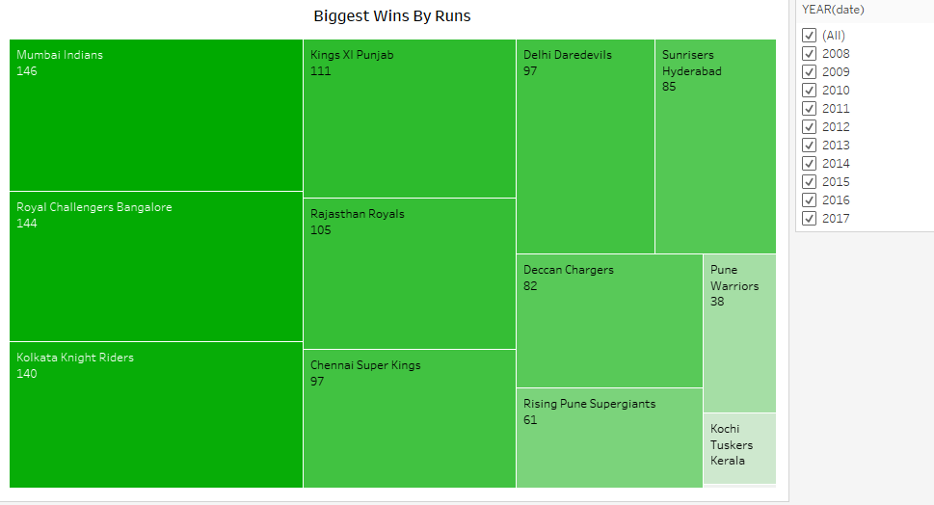
Mumbai Indians have biggest wins by runs across all the season.
Both Royal Challengers Bangalore and Chennai Super Kings have biggest wins by runs in 3 seasons each.

Slide 4
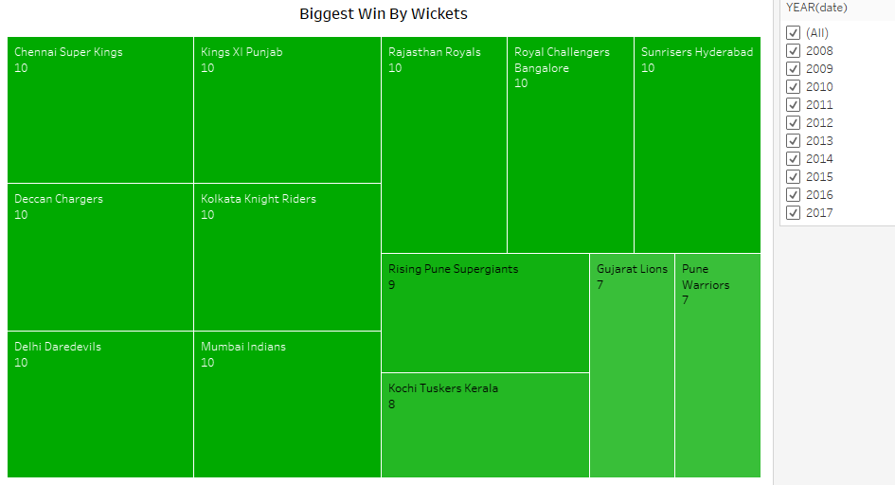
Chennai Super Kings have the biggest wins by wickets across all the seasons.
Royal Challengers Bangalore have the biggest wins by wickets in 2 seasons which are 2010 and 2015.

Slide 5
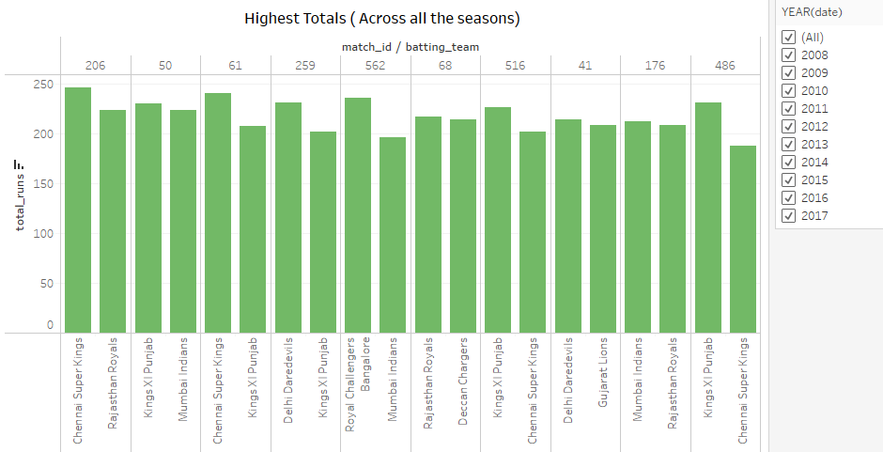
- Chennai Super Kings have scored 246 against Rajasthan Royals which is the Highest totals across all the seasons.

Slide 6
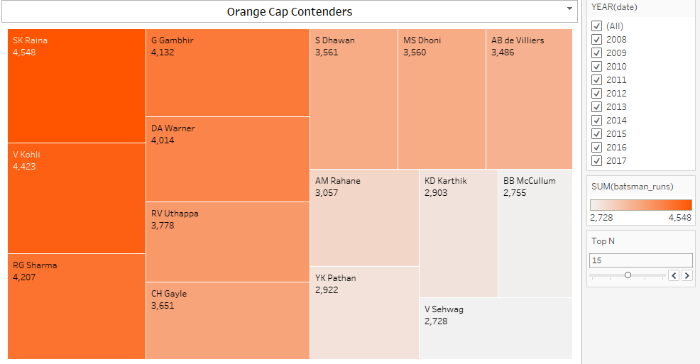
- SK Raina has scored most amount of runs across all the seasons , followed by V Kohli.

Slide 7
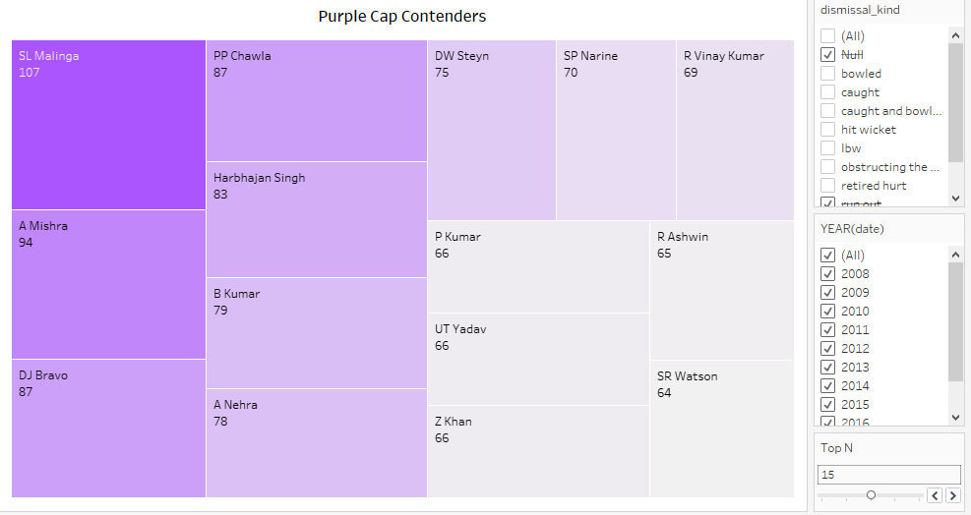
- SL Malinga have most number of wickets across all the seasons , followed by A Mishra.

Slide 8
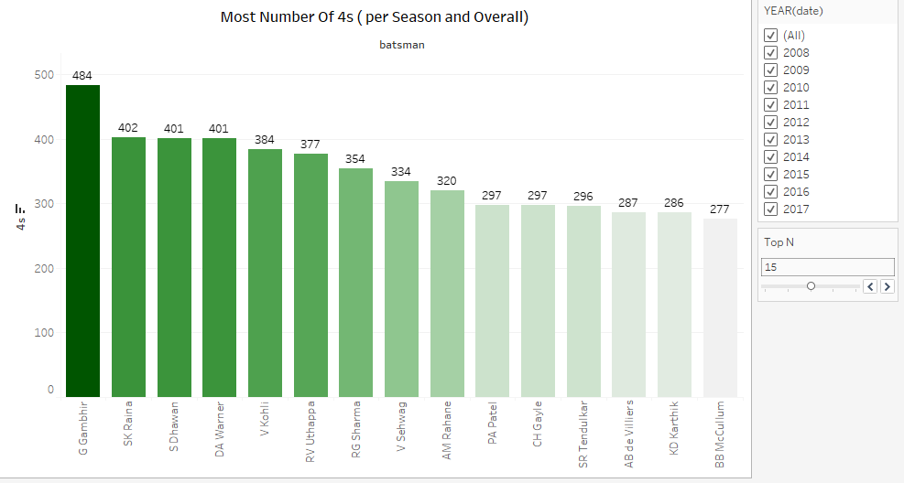
- G Gambhir has most number of 4s , followed by SK Raina.

Slide 9
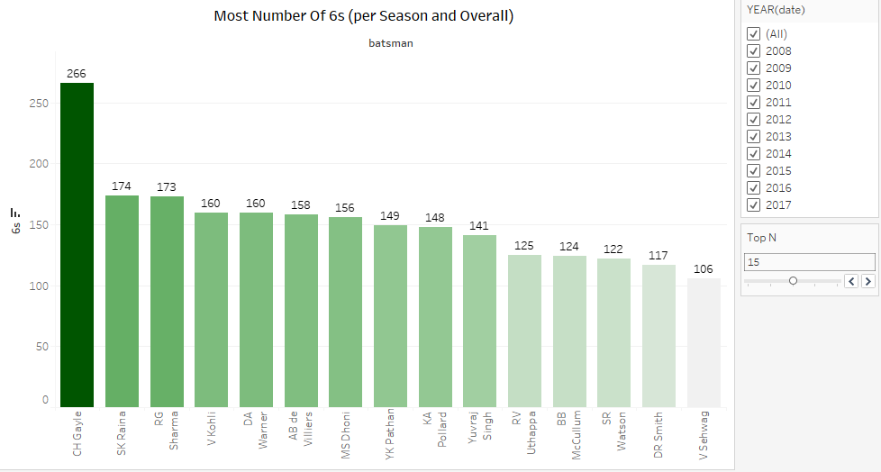
- CH Gayle has hit most number of 6s , followed by SK Raina.

Slide 10
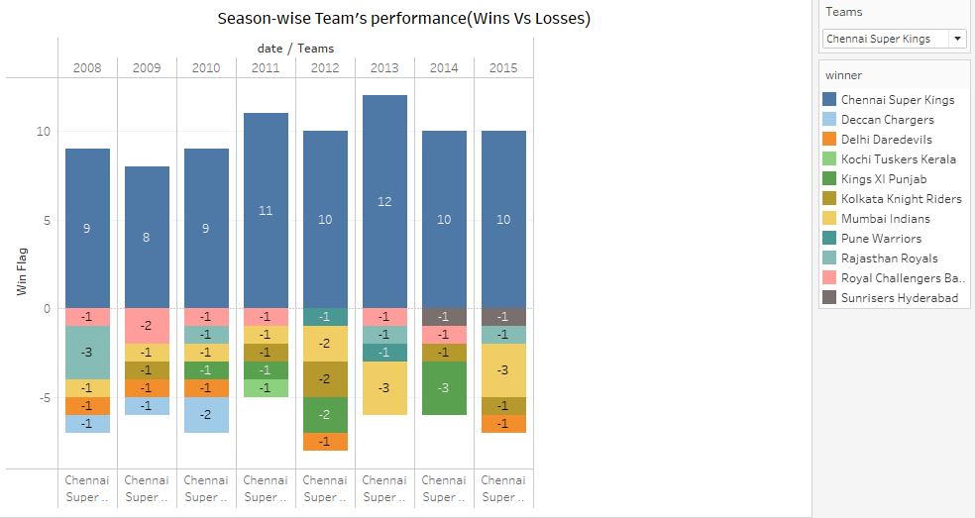
The Team performance can be seen across all season based on wins and losses.

Slide 11
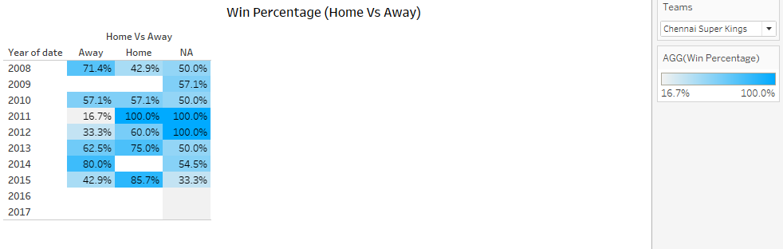
- Win percentage of each team is calculated across all the seasons based on Home and Away matches.

